Slide 1



[ DEPI — DATA ANALYTICS TRACK ]
VIDEO GAMES
GLOBAL MARKET ANALYSIS
1980 — 2020 | Final Project
TEAM MEMBERS
1. Mohamed Magdy Sayed Abd Elwahab
2. Mohamed Hany Abdullah Abdullah
3. Ahmed Hussein Mohamed Elhadidy
4. Amr Mohamed Abdelshahid Mostafa
SUBMISSION DATE: JULY 2026
Notes:
Good morning to the panel of doctors and esteemed committee members. We are honored to present our graduation project today for the Data Analytics track of the DEPI Digital Egypt Pioneers Initiative. Our project is titled Video Games Global Market Analysis, and our core objective is to integrate and analyze four full decades of gaming market data to extract strategic business decisions. It is my pleasure to introduce the team behind this project's engineering.

Slide 2
PROJECT OVERVIEW
Project Quest & Scope
THE CHALLENGE
TARGET METRICS
Harmonizing 40 years of fragmented gaming sales data across multiple console generations and regional distribution networks.
8.81B USD
11,920
13.53%
Total Global Sales
Total Games Analyzed
Achieved “Million-Seller” Status
THE MISSION CORE
Ingest, clean, model, and visualize historical sales data to extract multi-layered market insights.
SCOPE COVERAGE
Timeframe: 1980 – 2020 (40 years) Regions Covered: North America, Europe, Japan, Rest of World
02 / 14
Notes:
The historical challenge in the gaming industry has always been the fragmentation of data across different hardware generations. We took on this mission and analyzed data spanning 1980 to 2020 across 4 major world regions. Our pipeline successfully analyzed 11,920 games with a staggering total sales volume of 8.81 billion dollars, and we were able to precisely determine that only 13.53% of games in the market achieve Million-Seller hit status.

Slide 3
RESEARCH FRAMEWORK
Key Strategic Business Questions
Our initial brainstorming workshop yielded 12 operational questions, synthesized into 4 core strategic pillars:
01
Regional Revenue Dynamics & Cultural Preferences
02
Portfolio Safety & Historical Viability
Where is the money? Do NA, EU, and JP consumers share the same gaming taste?
Which genres are the safest investments? What is the probability of a title hitting 1M sales?
03
Hardware Longevity & Platforms
04
Publisher Market Share & Hit Density
Which console generated unmatched revenue, and what is their average lifespan?
Who is the ultimate industry giant in revenue and high-performing title delivery?
03 / 14
Notes:
To work in a sound business manner, we began the project with a shared team brainstorming session and drafted 12 precise business questions of the kind any investor would ask. For the sake of your valuable time, we distilled those 12 questions into 4 major strategic pillars that the dashboard directly answers: continental sales and cultural preferences, genre investment safety, average platform lifespan, and publisher dominance. The remaining questions are fully documented in the accompanying documentation file.

Slide 4
METHODOLOGY
Our End-to-End Data Pipeline
PYTHON
→
SQL SERVER
→
POWER BI
→
Dashboard UI/UX
PHASE 1
Preprocessing & Feature Engineering
Amr Mohamed
PHASE 2
Relational Data Warehousing & ERD
Mohamed Hany
PHASE 3
Analytical Star Schema & DAX Engine
Ahmed Hussein
PHASE 4
UI/UX Architecture & Data Story
Mohamed Magdy
04 / 14
Notes:
To arrive at this final product, we followed a complete, professional engineering pipeline. It starts with the Data Preprocessing phase in Python with our teammate Amr Mohamed, followed by Relational Warehousing and ERD design in SQL Server with our teammate Mohamed Hany, then Analytical Data Modeling and DAX formula writing with our teammate Ahmed Hussein, and finally the UI/UX and Data Storytelling phase with myself. I will now hand the microphone to Amr to walk us through the first step.

Slide 5
STEP 1 — AMR MOHAMED
Data Preprocessing & Feature Engineering
preprocess.py
DATA CLEANSING PROTOCOLS
def decade(year):
if year < 1990:
return "1980s"
elif year < 2000:
return "1990s"
elif year < 2010:
return "2000s"
else:
return "2010s"
df["Decade"] = df["Year"].apply(decade)
def million_seller(x):
if x >= 1:
return "Yes"
else:
return "No"
df["Million_Seller"] = df["Global_Sales"].apply(million_seller)
Handled historical missing values (e.g., null release years) dynamically via Python.
Standardized regional and global revenue records to eliminate computation discrepancies.
NEW FEATURES ENGINEERED
Hardware Manufacturer —
Grouped platforms into parent brands (Sony, Microsoft, Nintendo, Sega).
Release Decade —
Segmented years into clear structural decades (80s, 90s, 00s, 10s).
Million-Seller Flag —
Binary classifier for elite titles (≥ 1.0M copies).
05 / 14
Notes:
Thank you, Mohamed. Hello everyone — I received the raw data, which had several flaws and missing values, such as games without an explicit release year. Using Python I performed the Data Cleaning step and fully resolved these issues to guarantee the integrity of the numbers. I then performed a highly valuable technical step called Feature Engineering: I derived 3 new variables to enrich the analysis — a column grouping hardware into parent manufacturers, a column classifying games into release decades, and a final column that instantly flags whether a title has broken the one-million-copy mark. With that, the data was handed off clean and ready for the SQL step.

Slide 6
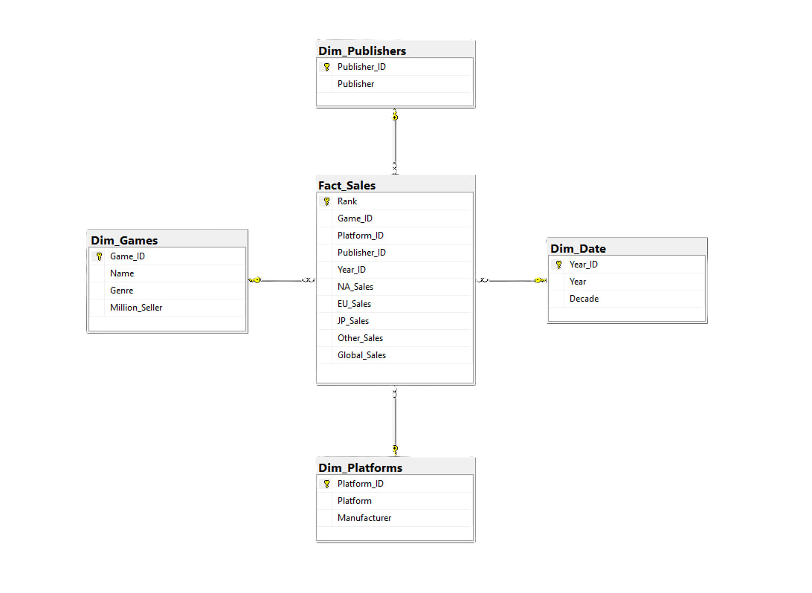
STEP 2 — MOHAMED HANY
Relational Data Warehousing
SCHEMATIC NORMALIZATION
Deconstructed the flat 16,000-row source file into a modular 4-table relational database architecture to eliminate anomalies and redundancy.
06 / 14
Notes:
Thank you, Amr. After receiving the clean and enriched data, we needed to load it into an SQL Server database to keep the project at an enterprise-grade standard. To prevent data anomalies and redundancy, I broke the large flat table into 4 relational tables based on Normalization principles: a central Fact_Sales table connected to three supporting dimension tables — Dim_Games, Dim_Platforms and Dim_Date. The ERD shown here maps those relationships and ensures fast queries, and from there the tables were handed off to Ahmed to build the model.

Slide 7
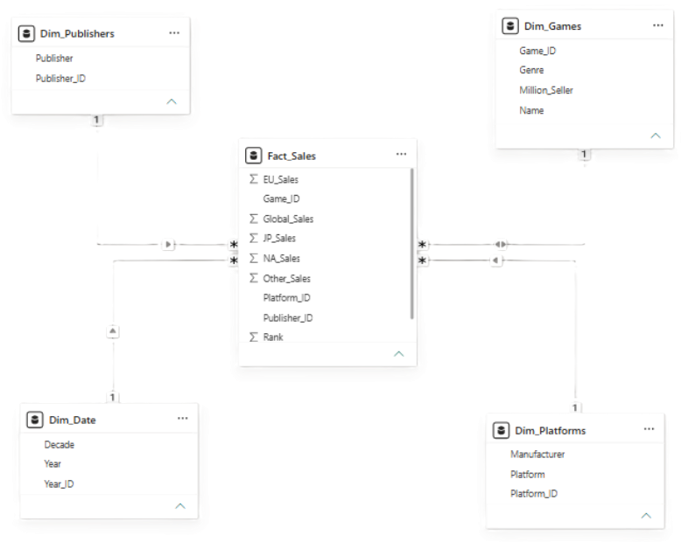
STEP 3 — AHMED HUSSEIN
Analytical Data Modeling
POWER BI MODEL VIEW
THE STAR SCHEMA
Implemented a highly optimized analytical Star Schema for seamless data mashups.
Configured strict One-to-Many (1:*) joins radiating from dimension tables to the Fact table.
PROPAGATION ENGINE
Activated bi-directional filtering (Cross Filter Direction = “Both”) on core dimensions.
Result: Dynamic filtering across all visuals.
07 / 14
Notes:
Thank you, Hany. I received the 4 tables inside Power BI and built our analytical model as a professional Star Schema, connecting the tables with One-to-Many relationships. The technical secret that keeps every chart and filter perfectly synchronized in real time, without any lag, was setting the Cross Filter Direction to Both on the core dimension tables — which is what guaranteed sub-1-second filtering latency.

Slide 8
STEP 3 (CONT.) — AHMED HUSSEIN
Core Analytical DAX Expressions
Platform Lifespan
STRATEGIC USE
Platform_Lifespan_Years =
[Platform_Last_Year] -
[Platform_First_Year] + 1
Quantifies active console market duration.
Hit Success Rate
STRATEGIC USE
Million_Seller_Percentage =
DIVIDE(
[Million_Seller_Games_Count],
[Total_Games])
Computes exact hit probability (13.53%) over 40 years.
Top Publisher
STRATEGIC USE
Top_Publisher_Million_Sellers =
VAR t = ADDCOLUMNS(
VALUES(Dim_Publishers[Publisher]),
"MS", [Publisher_Million_Sellers])
VAR Top1 = TOPN(1, t, [MS], DESC)
RETURN MAXX(Top1, Dim_Publishers[Publisher])
Dynamically isolates top-performing entities upon slicing.
08 / 14
Notes:
To surface strategic business figures, I wrote advanced custom DAX formulas: a precise Platform Lifespan calculation, and a Million Seller Percentage measure. I also used variables, TOPN, and MAXX techniques to dynamically rank the top-performing platforms and publishers as filters change. I'll now hand the microphone back to Mohamed Magdy to present the interface and live demo.

Slide 9
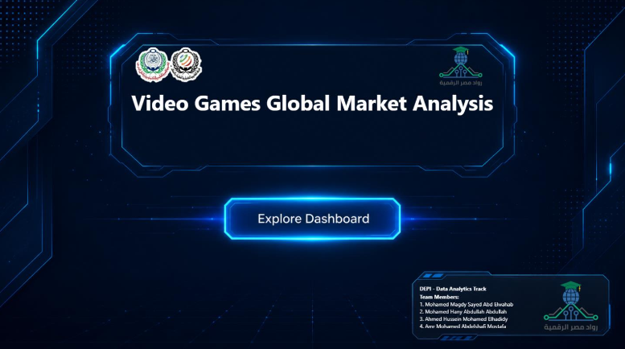
STEP 4 — MOHAMED MAGDY
Dashboard Interface & User Experience
DASHBOARD FEATURES
DASHBOARD LANDING PAGE
Adopted a dark gaming-inspired theme to match the project domain.
Designed a consistent layout across all dashboard pages.
Used KPI cards to highlight the most important business metrics.
Applied interactive slicers and cross-filtering for dynamic analysis.
DASHBOARD CAPABILITIES
Interactive navigation between report pages.
Dynamic filtering across all visuals.
Clear visual hierarchy for faster insight discovery.
Business-focused layout that supports decision making.
Design Goal: Create an interactive dashboard that transforms historical gaming data into clear, actionable business insights.
09 / 14
Notes:
Thank you, Ahmed. Now comes the visual interface, UX, and data storytelling. Since our topic is video games, we deliberately moved away from traditional white dashboards and designed a Futuristic Gaming HUD Dark Theme to match the industry and reduce visual fatigue. We paid close attention to spatial management, shrinking metadata card fonts to 8pt to eliminate nested scrollbars — a common bad practice in analytical interfaces — and used flexible side navigation buttons so the experience feels like a real software application.

Slide 10
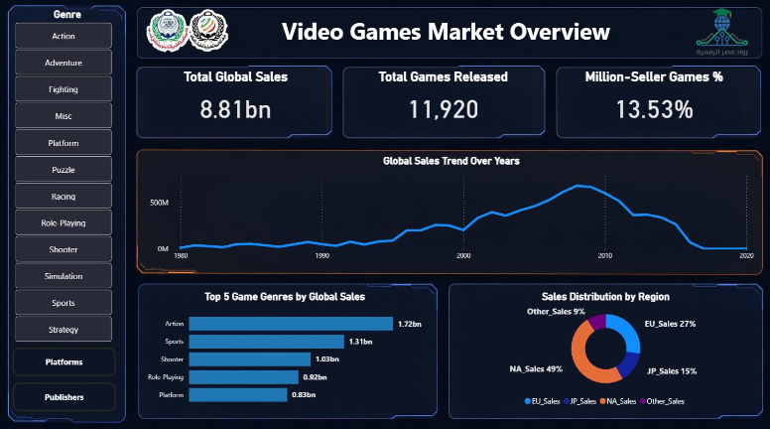
LIVE DEMO — SCREEN 1
Global Market Overview
ANSWERING Q1 — REGIONAL DOMINANCE
49%
North America (NA) stands as the absolute economic locomotive, capturing 49% (4.3B USD) of the global historical footprint.
ANSWERING Q2 — PORTFOLIO SAFETY & TIMING
Action ($1.72B) and Sports ($1.31B) combine to yield over $3.0B USD, proving the historically safest investments.
Temporal trends confirm the massive exponential explosion of global gaming sales occurred at the turn of the 2000s decade.
10 / 14
Notes:
If we open the first screen of the application, the Market Overview, the dashboard directly answers our first two research pillars: continental sales are clear — North America alone dominates with 49% of total worldwide sales. From the timeline we can see that the real explosion in gaming sales began with the turn of the millennium, and that the historically safe investment categories are Action and Sports games, exceeding 3 billion dollars combined.

Slide 11
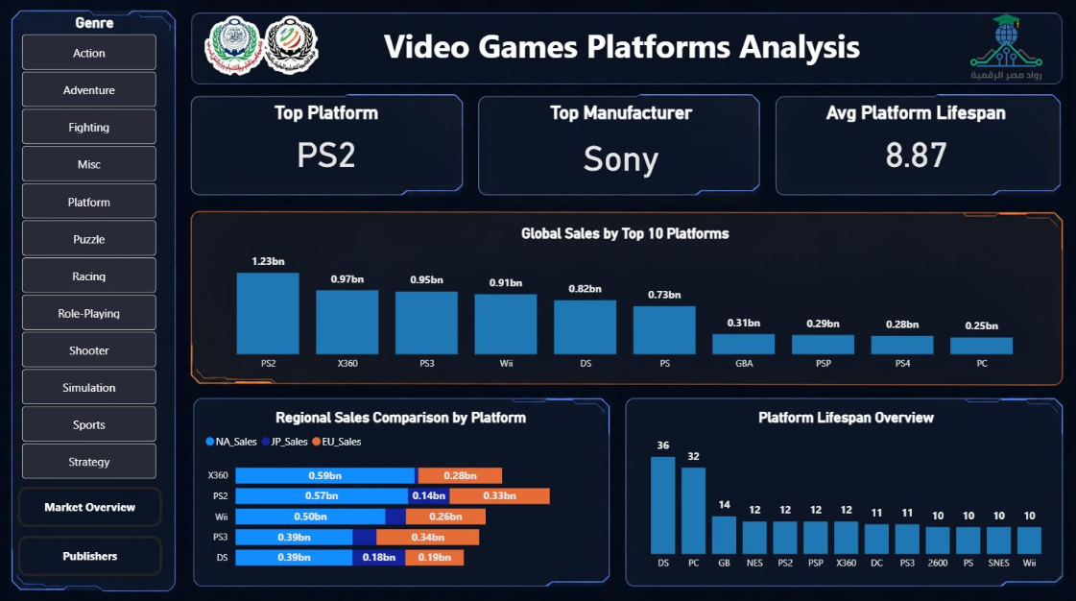
LIVE DEMO — SCREEN 2
Platform Longevity & Hardware Performance
ANSWERING Q3 — CONSOLE LONGEVITY
Undisputed Hardware King
1.23B USD
Sony PlayStation 2 (PS2) reigns supreme in historical revenue.
Lifecycle Benchmarking
8.87 yrs
Analytical modeling reveals the historical average lifespan of gaming hardware.
11 / 14
Notes:
On the second screen, covering platforms and hardware, we answer the console longevity pillar: the analysis proves that the Sony PS2 is the single strongest-selling platform in gaming history, generating 1.23 billion dollars. Our DAX measures reveal that the average lifespan of a platform in the market is 8.87 years. Some hardware lived for decades, like PC at 32 years, while others such as the Atari 2600 and Sega Genesis lived commercially for exactly 10 years.

Slide 12
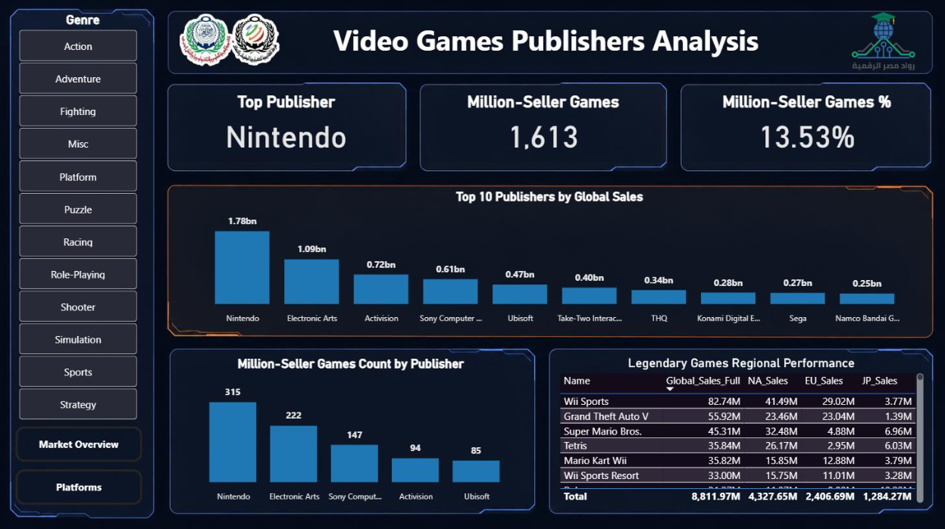
LIVE DEMO — SCREEN 3
Publisher Performance & Best-Selling Games
BEST-SELLING GAME
Wii Sports
82.74M
copies sold worldwide — stands as the single highest-selling game title in human history.
ANSWERING Q4 — PUBLISHER DENSITY
Top Publisher: Nintendo
1.78B USD
in global sales — the absolute titan of software publishing.
315 titles
Million-Seller games injected into the market by Nintendo alone — the highest hit-volume density in the industry.
12 / 14
Notes:
On the third screen, covering publishers and companies, we uncover the secret behind Million-Sellers: Nintendo is the undisputed historical leader with total sales of 1.78 billion dollars and the highest density of commercial hits at 315 Million-Seller games. The dashboard also surfaces the legendary title leaderboard, topped by Wii Sports with a historic and almost unbelievable figure of 82.74 million copies sold worldwide.

Slide 13
BUSINESS RECOMMENDATIONS
Strategic Recommendations
Geographic Localization
1
Publishers should prioritize the North American market, which accounts for 49% of total sales.
Genre Risk Management
2
Prioritize Action and Sports games for global audiences, while targeting Role-Playing games to the Japanese market based on regional preferences.
Software Development Roadmaps
3
Align product development cycles with the historical average platform lifespan (8.87 years).
13 / 14
Notes:
In conclusion, we translate this data into concrete business decisions and strategic recommendations. First, 49% of marketing and localization budgets should be directed toward the North American market, as it remains the largest financial engine. Second, Action and Sports titles are the safest global bet, but any RPG title should be specifically localized for the Japanese market, where the genre historically dominates. Third, development studios should align their production cycles and budgets with the average 8.87-year platform lifespan to maximize returns before a platform commercially declines.

Slide 14
[ MISSION COMPLETE ]
Thank You for Your Time
Open for Questions & Discussion
14 / 14
Notes:
With that, we've reached the end of the pipeline and the end of our presentation today. Thank you very much for your attention and for your valuable time. We are fully prepared and ready now for the discussion questions and our boss fight with the committee.

